Slide 1
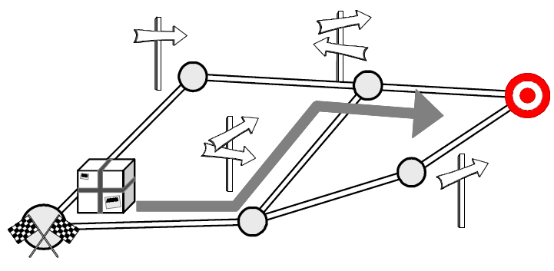
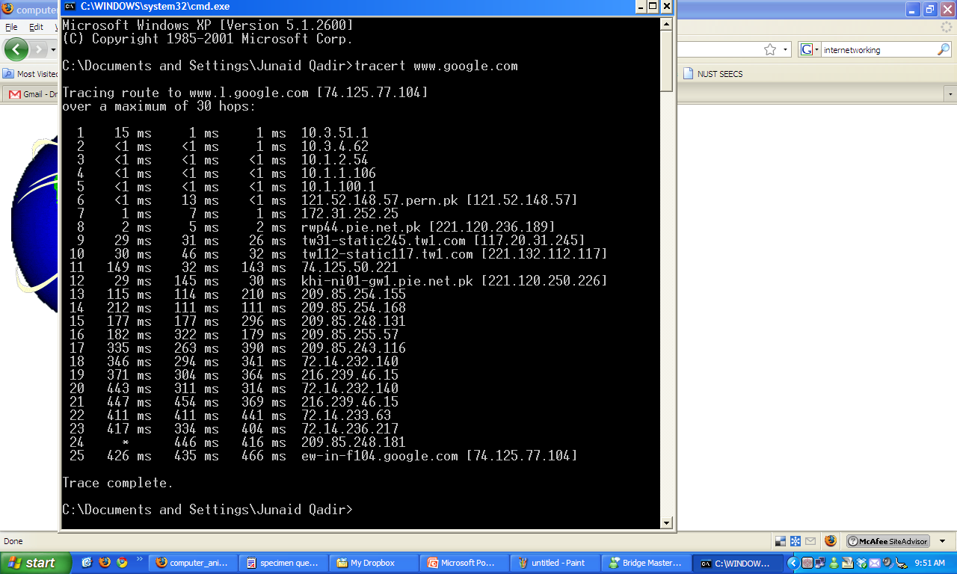
Topic 3; Lecture 2
How to route packets?
Notes:
In the previous lectures, we have assumed that the switches and routers have enough knowledge of the network topology so they can choose the right port onto which each packet should be output. In the case of virtual circuits, routing is an issue only for the connection request packet; all subsequent packets follow the same path as the request. In datagram networks, including IP networks, routing is an issue for every packet. In either case, a switch or router needs to be able to look at the packet’s destination address and then to determine which of the output ports is the best choice to get the packet to that address. As we saw in previous lectures, the switch makes this decision by consulting a forwarding table. The fundamental problem of routing is, How do switches and routers acquire the information in their forwarding tables?

Slide 2
Topic’s objectives
To learn about:
1 – Static vs. Dynamic Routing
2 – Scalable Hierarchical Routing
3 – Distance Vector Routing Protocols

Slide 3

Routing

Slide 4
Network Layer- Routing
The main task of any network layer is routing
Route: [m-w.org] Inflected Form(s): rout·ed; rout·ing 1 : to send by a selected route : DIRECT <was routed along the scenic shore road> 2 : to divert in a specified direction

Slide 5
Network Layer-Routing
The main task of the network layer is routing
Route packets from a source to a destination using as few hops as possible
Each router maintains and periodically updates a routing table
Routing information is shared among routers
Routing algorithm

Slide 6
Optimization Goals
General answers appear impossible, but a few aspects should be considered
– Quality of Service
– Energy Efficiency [Now Energy Provisioning]
– Scalability
– Robustness

Slide 7
Classification of Routing protocols
Routing Protocols
Based on Routing information update mechanisms
Based on use of temporal information for routing
Based on topology information organization
Based on utilization of specific resources
Flat Routing
Hierarchal Routing
Table driven Proactive
On demand Reactive
Hybrid
Path selection using Path history
Power Aware Routing
Routing with efficient flooding
Notes:
In a flat routing infrastructure, each network ID is represented individually in the routing table. The network IDs have no network/subnet structure and cannot be summarized. RIP-based IPX internetworks use flat network addressing and have a flat routing infrastructure.
In a hierarchical routing infrastructure, groups of network IDs can be represented as a single routing table entry through route summarization. The network IDs in a hierarchical internetwork have a network/subnet/sub-subnet structure. A routing table entry for the highest level (the network) is also the route used for the subnets and sub-subnets of the network. Hierarchical routing infrastructures simplify routing tables and lower the amount of routing information that is exchanged, but they require more planning. IP implements hierarchical network addressing, and IP internetworks can have a hierarchical routing structure.
In hierarchical routing infrastructures, the internetwork can be divided into routing domains (also known as regions or areas). A routing domain is a collection of contiguous networks connected by routers that share the routing information for the routes within the domain. Routing domains are connected by a common routing domain called the backbone. Intra-domain routing is performed by the routers within the domain. Inter-domain routing is performed by domain routers connected to the backbone.

Slide 8
[ End of lecture ]

